Slide 1
The Relational Algebra-II (JOINS)

Slide 2
General Guideline
© (2021) ABES Engineering College.
This document contains valuable confidential and proprietary information of ABESEC. Such confidential and proprietary information includes, amongst others, proprietary intellectual property which can be legally protected and commercialized. Such information is furnished herein for training purposes only. Except with the express prior written permission of ABESEC, this document and the information contained herein may not be published, disclosed, or used for any other purpose.

Slide 3
Session Plan
1.Cartesian Product
2. Join Operations
3. Inner Joins
4. Theta join
5. EQUI join
6. Natural join

Slide 4
Cartesian Product

Slide 5
Introduction – Cartesian Product
Cartesian Product in DBMS is an operation used to combine tuples from two relations in a combinatorial fashion.
It is also called Cross Product or Cross Join.
Very rare in practice; mainly used to express joins
Denoted by R(A1, A2, . . ., An) x S(B1, B2, . . ., Bm)
If relation R1 has n tuples and relation R2 has m tuples , total tuples in R1 × R2 will be n * m.
Result is a relation Q with degree n + m attributes:
Q(A1, A2, . . ., An, B1, B2, . . ., Bm), in that order.
The two operands do NOT have to be "type compatible”

Slide 6
Cartesian Product (Contd.)
A | B
α | 1
α | 2
C | D | E
α | 10 | a
A | B | a
α | 1 | b
α | 2 | b
A | B | C | D | E
α | 1 | α | 10 | a
α | 1 | A | B | a
α | 1 | α | 1 | b
α | 1 | α | 2 | b
α | 2 | α | 10 | a
α | 2 | A | B | a
α | 2 | α | 1 | b
α | 2 | α | 2 | b
X

Slide 7
Cartesian Product (Contd.)
Generally, CROSS PRODUCT is not a meaningful operation
Can become meaningful when followed by other operations
Example (not meaningful):Suppose that we want the dependents of all female employees.
FEMALE_EMPS ← σ _{GENDER=’F’}(EMPLOYEE)
EMPNAMES ← π _{FNAME, LNAME, SSN} (FEMALE_EMPS)
EMP_DEPENDENTS ← EMPNAMES x DEPENDENT
EMP_DEPENDENTS will contain every combination of EMPNAMES and DEPENDENT
whether or not they are actually related

Slide 8
Cartesian Product (Contd.)
To keep only combinations where the DEPENDENT is related to the EMPLOYEE, we add a SELECT operation as follows
Example (meaningful):
FEMALE_EMPS ← σ _{GENDER=’F’}(EMPLOYEE)
EMPNAMES ← π _{FNAME, LNAME, SSN} (FEMALE_EMPS)
EMP_DEPENDENTS ← EMPNAMES x DEPENDENT
ACTUAL_DEPS ← σ _{SSN=ESSN}(EMP_DEPENDENTS)
RESULT ← π _{FNAME, LNAME, DEPENDENT_NAME} (ACTUAL_DEPS)
RESULT will now contain the name of female employees and their dependents

Slide 9
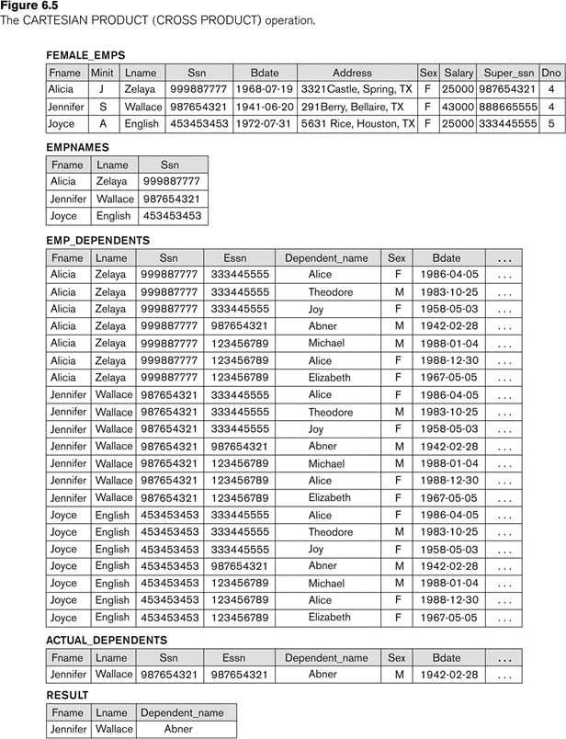

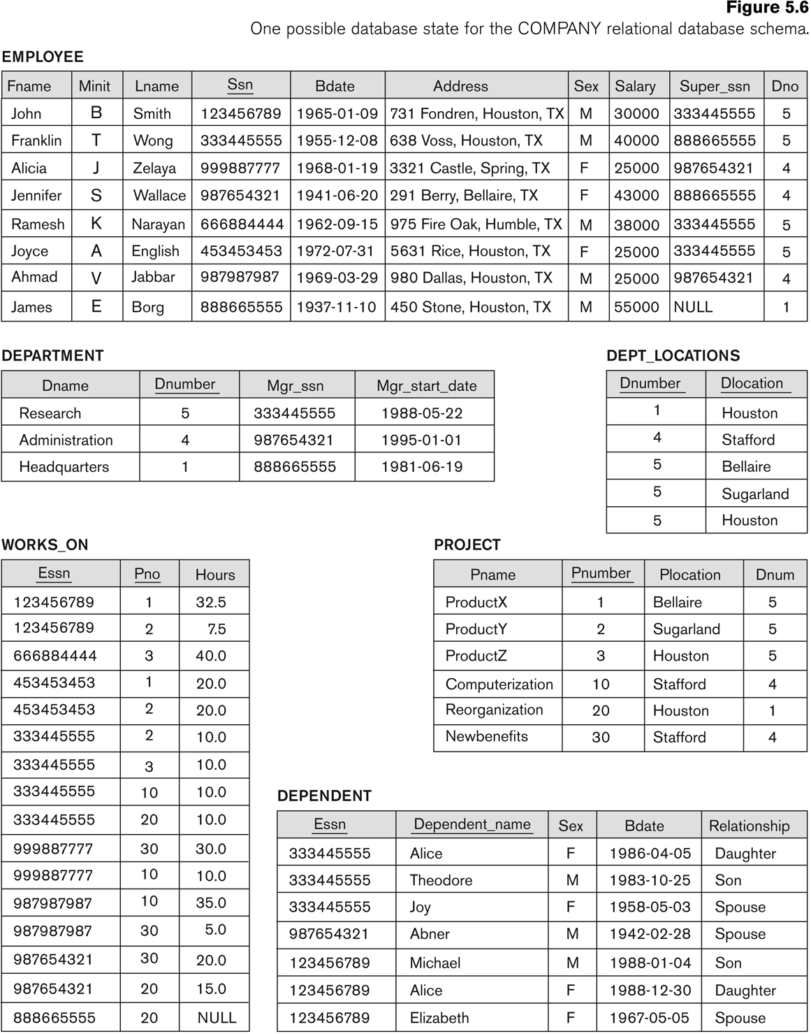
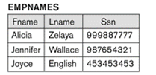
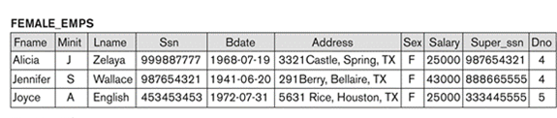
Cartesian Product (Contd.)

Slide 10
JOIN OPERATION

Slide 11
Join Operation
The sequence of CARTESIAN PRODECT followed by SELECT is used quite commonly to identify and select related tuples from two relations .A special operation, called JOIN combines this sequence into a single operation
This operation is very important for any relational database with more than a single relation, because it allows us combine related tuples from various relations
The general form of a join operation on two relations R(A1, A2, . . ., An) and S(B1, B2, . . ., Bm) is:
R _{<join condition>}S
where R and S can be any relations that result from general relational algebra expressions.

Slide 12
Some properties of JOIN
Consider the following JOIN operation:
R(A1, A2, . . ., An) S(B1, B2, . . ., Bm)
Result is a relation Q with degree n + m attributes:
Q(A1, A2, . . ., An, B1, B2, . . ., Bm), in that order.
The resulting relation state has one tuple for each combination of tuples—r from R and s from S, but only if they satisfy the join condition r[Ai]=s[Bj]
Hence, if R has n_{R} tuples, and S has n_{S} tuples, then the join result will generally have less than n_{R} * n_{S} tuples.
Only related tuples (based on the join condition) will appear in the result
R.Ai=S.Bj

Slide 13
Join Operation (Contd.)
Example: Suppose that we want to retrieve the name of the manager of each department.
To get the manager’s name, we need to combine each DEPARTMENT tuple with the EMPLOYEE tuple whose SSN value matches the MGRSSN value in the department tuple.
We do this by using the join operation.
DEPT_MGR ← DEPARTMENT _{MGRSSN=SSN} EMPLOYEE
MGRSSN=SSN is the join condition
Combines each department record with the employee who manages the department
The join condition can also be specified as DEPARTMENT.MGRSSN= EMPLOYEE.SSN

Slide 14
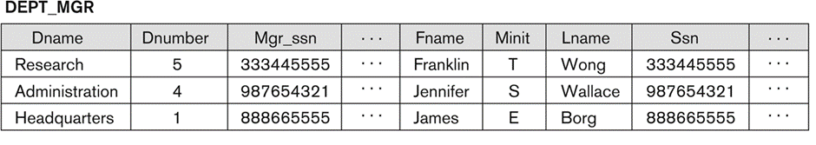
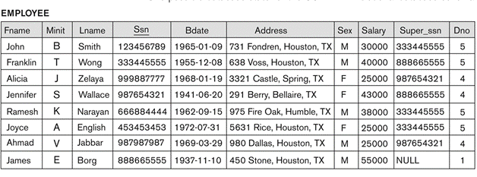
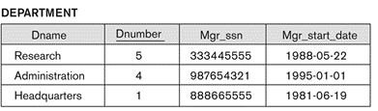
Join Operation (Contd.)

Slide 15
Types of Joins
There are mainly two types of joins in DBMS:
Inner Joins:
Theta
Natural
EQUI
Outer Join:
Left
Right
Full

Slide 16
INNER JOIN

Slide 17
Inner Joins
INNER JOIN is used to return rows from both tables which satisfy the given condition. It is the most widely used join operation and can be considered as a default join-type.
It comes in three flavors :
THETA JOIN
EQUIJOIN
NATURAL JOIN

Slide 18

Theta Join
THETA JOIN allows you to merge two tables based on the condition represented by theta (θ).
It is the most general Join Operation.
It is the result of performing a SELECT operation on the product.
Theta joins work for all comparison operators.
It is denoted by symbol θ.
The general form of a theta join operation on two relations R(A1, A2, . . ., An) and S(B1, B2, . . ., Bm) is:
where R and S can be any relations that result from general relational algebra expressions.
Algebraic Rule:
Physically, the join of R1 and R2 with the condition theta is the same than the selection of the cross product of R1 and R2 with the condition theta.
θ

Slide 19
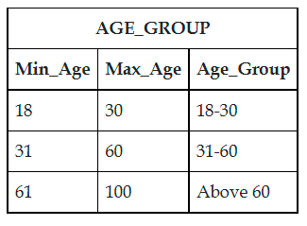
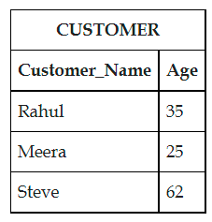
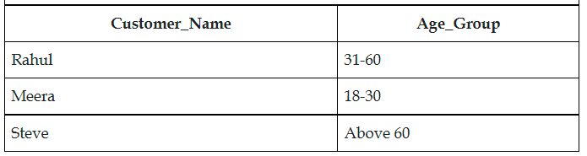
Theta Join
Example: Display the name of the customer along with the age group in which his/her age lies.
π_{customer_name, age_group}(σage >= min_age ^ age <= max_age (customer X age_group))

Slide 20

EQUIJOIN
The most common use of join involves join conditions with equality comparisons only
EQUI JOIN is done when a Theta join uses only the equivalence condition.
EQUI join is the most difficult operation to implement efficiently in an RDBMS, and one reason why RDBMS have essential performance problems.
Such a join, where the only comparison operator used is =, is called an EQUIJOIN.
In the result of an EQUIJOIN we always have one or more pairs of attributes (whose names need not be identical) that have identical values in every tuple.
Relational Syntax :

Slide 21
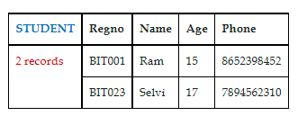
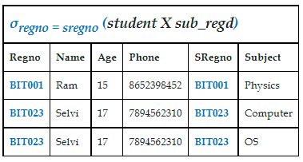
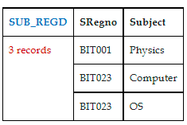
EQUIJOIN
Example: Show the details of the student and the subject registered by him.

Slide 22

Natural Join
Another variation of JOIN called NATURAL JOIN — denoted by * — was created to get rid of the second (superfluous) attribute in an EQUIJOIN condition.
because one of each pair of attributes with identical values is superfluous
The standard definition of natural join requires that the two join attributes, or each pair of corresponding join attributes, have the same name in both relations
If this is not the case, a renaming operation is applied first.
We can perform a Natural Join only if there is at least one common attribute that exists between two relations.
A natural join is a shorthand equi-join where the equality applied to all shared attributes.
where: attrs(R)∩attrs(S) is the intersection of the attributes of R and S.

Slide 23
Natural Join
Example 1: To apply a natural join on the DNUMBER attributes of DEPARTMENT and DEPT_LOCATIONS, it is sufficient to write:
DEPT_LOCS ← DEPARTMENT * DEPT_LOCATIONS
Only attribute with the same name is DNUMBER
An implicit join condition is created based on this attribute:
DEPARTMENT.DNUMBER=DEPT_LOCATIONS.DNUMBER
Example 2: Q ← R(A,B,C,D) * S(C,D,E)
The implicit join condition includes each pair of attributes with the same name, “AND”ed together:
R.C=S.C AND R.D.S.D
Result keeps only one attribute of each such pair:
Q(A,B,C,D,E)

Slide 24
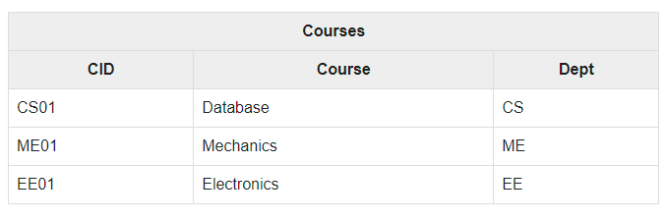
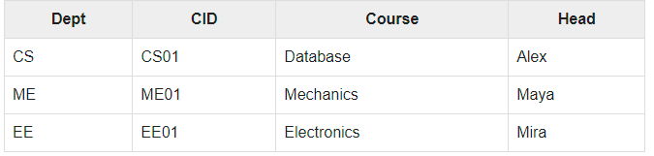
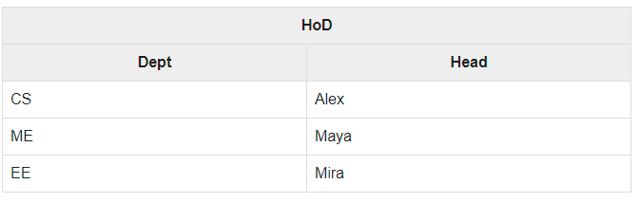
Natural Join
Courses * HoD

Slide 25
Can you answer ?
PLEASE ANWER THESE QUESTIONS BASED ON COMPANY DATABASE
Q1: Retrieve the name and address of all employees who work for the ‘Research’ department.
RESEARCH_DEPT ← σ DNAME=’Research’ (DEPARTMENT)
RESEARCH_EMPS ← (RESEARCH_DEPT _{DNUMBER= DNOEMPLOYEE}EMPLOYEE)
RESULT ← π FNAME, LNAME, ADDRESS (RESEARCH_EMPS)
Q6: Retrieve the names of employees who have no dependents.
ALL_EMPS ← π SSN(EMPLOYEE)
EMPS_WITH_DEPS(SSN) ← π ESSN(DEPENDENT)
EMPS_WITHOUT_DEPS ← (ALL_EMPS - EMPS_WITH_DEPS)
RESULT ← π LNAME, FNAME (EMPS_WITHOUT_DEPS * EMPLOYEE)

Slide 26
Can you answer ?
PLEASE ANWER THESE QUESTIONS BASED ON COMPANY DATABASE
Q1: Retrieve the name and address of all employees who work for the ‘Research’ department.
RESEARCH_DEPT ← σ DNAME=’Research’ (DEPARTMENT)
RESEARCH_EMPS ← (RESEARCH_DEPT _{DNUMBER= DNOEMPLOYEE}EMPLOYEE)
RESULT ← π FNAME, LNAME, ADDRESS (RESEARCH_EMPS)
Q6: Retrieve the names of employees who have no dependents.
ALL_EMPS ← π SSN(EMPLOYEE)
EMPS_WITH_DEPS(SSN) ← π ESSN(DEPENDENT)
EMPS_WITHOUT_DEPS ← (ALL_EMPS - EMPS_WITH_DEPS)
RESULT ← π LNAME, FNAME (EMPS_WITHOUT_DEPS * EMPLOYEE)

Slide 27
Thank You

